Slide 1
20. Further Programming
Understanding what is meant by a programming paradigm
Show understanding of the characteristics of a number of programming paradigms:
Low-level Programming:
• understanding of and ability to write low-level code that uses various addressing modes: immediate, direct, indirect, indexed and relative
Imperative (Procedural) programming:
Assumed knowledge and understanding of Structural Programming (see details in AS content section 11.3)
understanding of and ability to write imperative (procedural) programming code that uses variables, constructs, procedures and functions. See details in AS Content
Object-Oriented Programming (OOP):
understanding of the terminology associated with OOP (including objects, properties, methods, classes, inheritance, polymorphism, containment (aggregation), encapsulation, getters, setters, instances)
understanding of how to solve a problem by designing appropriate classes
understanding of and ability to write code that demonstrates the use of OOP
Declarative programming:
understanding of and ability to solve a problem by writing appropriate facts and rules based on supplied information
understanding of and ability to write code that can satisfy a goal using facts and rules

Slide 2
Today
Understanding what is meant by a programming paradigm
Show understanding of the characteristics of a number of programming paradigms:
Low-level Programming:
• understanding of and ability to write low-level code that uses various addressing modes: immediate, direct, indirect, indexed and relative
Imperative (Procedural) programming:
Assumed knowledge and understanding of Structural Programming (see details in AS content section 11.3)
understanding of and ability to write imperative (procedural) programming code that uses variables, constructs, procedures and functions. See details in AS Content
Understand: What is a programming paradigm
Able: Describe the different paradigm
Answer: Why use one paradigm over another?

Slide 3
Programming Paradigm
There are many different ways to code.
One way is to use code which deals directly with the CPU (Assembly language)
Another way is to write code and it executes one thing after another in order. You write the code for Task A, then Task B, then Task C and the computer runs Task A, then B then C in the order you wrote it.
One more way is you use Objects and Classes so you can write your code anywhere you like and you just call on your code when needed.
So you can write Task A, then Task F, then Task C, then Task B but then you call them in the order you want not the order you wrote them with
A final way to program code is where you tell the computer what you want the answer to be and let the computer work out how to get there.
All of these different ways are called Programming Paradigm
Paradigm = A way / concept of doing something

Slide 4
Programming Paradigm
Match up the types (green) with the definition (orange)
Uses Objects and Classes
Imperative / Procedural
The order you write your code is the order its run it
Use code that directly can talk to the CPU
You tell the computer the result you want and the computer handles the rest
Object Oriented (OOP)
Low Level
Declarative

Slide 5
Programming Paradigm
Match up the types (green) with the definition (orange)
Low Level
Object Oriented (OOP)
Use code that directly can talk to the CPU
Uses Objects and Classes
Imperative / Procedural
Declarative
You tell the computer the result you want and the computer handles the rest
The order you write your code is the order its run it

Slide 6
Low Level
When you write with code that the CPU can directly understand.
Assembly Language
Machine Code / Binary
Used for:
Printer drivers
Control Systems / Registers
Low level can communicate RAM. But we don’t say communicate, we say address
Low Level has different ways to address RAM
Absolute / Direct
Indirect
Indexed
Immediate
Relative
Symbolic

Slide 7
Absolute / Direct Addressing
You say the exact address you want.
You directly tell the address
If you say STO 316
Then it means store (STA) in memory location 316
LDD 12
Means load (LDD) whatever is in memory location 12

Slide 8
Indirect Addressing
With direct / absolute addressing, you say where you want to go and the value you want is in there.
With indirect addressing, you say where you want to go, but then that value is not the data you want but it says go somewhere else to find your value.
Example:
LDD 75
You say you want to load whatever is in memory location 75 (this is direct)
You go to location 75 and inside 75 it says 219. So now you go to 219.
Then inside location 219 is the value you really wanted.
Indirect addressing doesn’t just mean 1 hop, it could be LDD 75 > 219 > 32 > 4 …. Until you reach the value you want

Slide 9
Indexed Addressing
This type of addressing uses something called an Index Register (IR)
A register is just a small piece of memory inside the CPU that holds one value.
Indexed addressing means the address you type + whatever is in the IR is where you go to.
Example:
Your IR has the value 7
You want to go to memory location 100
You must type LDD 93
Why 93 if you want 100? Because 93 (the address you typed) + the 7 (the IR) = 100

Slide 10
Immediate addressing
With the other types of addressing you are saying go to a memory location and eventually give me the value from there and store it that value in the accumulator (ACC)
With immediate addressing you are not saying “go to this memory location and find a value to put in the ACC” you are saying: “put this value immediately in the ACC”
Example
LDD 56
This means go to location 56 and store that value in the ACC (Direct addressing)
LDD #56
This means put the value 56 immediately in the ACC. This is immediately addressing. Use the # symbol to know the difference between LDD 56 and LDD #56

Slide 11
Relative Addressing
Remember with Indexed Addressing we use an Index Register (IR). So the address we go to is whatever we typed + IR value.
Example:
Your IR is 7
You want to load memory location 100
You have to type LDD 93.
This will be 93 + 7 = 100
Well with Relative Addressing you don’t use an IR but you use the Program Counter (PC) itself.
Actually things differ here, some people say you use the Program Counter (PC) and other people say it uses the Current Instruction Register (CIR or IR)
Its harder to load items directly, because you have to keep track of where the data is within memory but its super easy to store things in memory without any clashes because you just use your value + CIR for the address

Slide 12
Symbolic Addressing (part 1)
Where you don’t say a number but a name instead
But you can’t say “name” you have to say either symbol or label.
You will need to have a symbol table.
Example:
LDD Batman
This will load whatever is inside memory location Batman
The symbol table shows that Batman is actually location 28 and holds the value 99
Label | Real location | Value
Batman | 28 | 99
Superman | 43 | 872

Slide 13
Symbolic Addressing (part 2)
Why use a symbol / label and not the number?
If you used direct addressing or any other addressing mode and then you change your program, you may have to change all the other locations, but with symbolic addressing, it doesn’t matter because you are referencing a label.
Symbolic addressing is only used for Assembly language.

Slide 14
Imperative Programming
This is how we all started.
Also called procedural
Your program runs in the same order that you typed it in.
It does not mean it uses an interpreter. Interpreter and complier is how your code gets translated. Procedural programming / Imperative programming just means whatever you typed first happens first.
After a while, they improved imperative programming by including procedures and functions

Slide 15
Procedure and Functions
You write some code at the start of the page, you want to use the same code later in your program. You can make your code at the start into a procedure
Procedure = Code that can run repeatedly from different parts of the program.
You need three things: PROCEDURE, ENDPROCEDURE and CALL
Example:
PROCEDURE TeachersA
PRINT “Amar” PRINT “Alice” PRINT “Ainur”
ENDPROCEDURE
This makes a procedure called TeachersA. The code within the procedure just prints out teacher names.
So later in your code you can have something like:
IF letter = A THEN
CALL TeachersA
ENDIF

Slide 16
Function
A procedure just does what you will tell it. In the other example it just prints ”Amar”, ”Alice” and “Ainur”
A function is exactly the same as a procedure but you have to give it value and it returns a value.
This is called passing values
FUNCTION (value to be passed in)
…
RETURN (value to be passed out)
ENDFUNCTION
You need four things for a function: FUNCTION, RETURN, ENDFUNCTION and CALL
FUNCTION Score_to_Percent (Score)
Percent ← (score / 75) * 100
RETURN Percent
ENDFUNCTION
Somewhere later in your code you can have:
Score ← 67
CALL Score_to_Percent(Score)

Slide 17
Today
Object-Oriented Programming (OOP):
understanding of the terminology associated with OOP (including objects, properties, methods, classes, inheritance, polymorphism, containment (aggregation), encapsulation, getters, setters, instances)
understanding of how to solve a problem by designing appropriate classes
understanding of and ability to write code that demonstrates the use of OOP
Understand: A whole bunch of terms for OOP
Able: Identify getters and setters
Answer: What is a class method?

Slide 18
Object Orientated Programming (OOP)
Oh my gosh…so so so so many stupid words here.
Object Orientated Programming (OOP) uses objects.
Objects are similar to procedures and functions
Objects are self contained pieces of code.
So what’s the difference between an object and procedure or function?
Not much, a procedure won’t give you anything in return, it will just run.
A function means you must give it something and it will give something to you
An object, we don’t care about the classification. Give it something, don’t give it something, we don’t care.
Also, objects can interact with each other

Slide 19
OOP Terms
An Object cannot just be made by magic, you need to make a Class.
A Class is used to create an Object
So now we have two words:
Class : Used as a template to create an object
Object : Self contained code
We will now need to learn all of these words:
Properties, Methods, Instance, Inheritance, Polymorphism, Containment, Aggregation, Encapsulation, Deconstruction, Getters, Setters, Attributes, Public, Private, Behaviours

Slide 20
OOP Terms – Classes (part 1)
So a class is used as a template to create an object
Classes have names, attributes, methods, public sets, private sets and encapsulation.
Lets say you want a program that draws shapes. (Square, Triangle, Circle etc…)
The actual shape (square, triangle, circle etc…) is the object.
But you need to make a template on how to make that object. That template is called a class.
So a shape can have an area size, the perimeter size and a name

Slide 21
OOP Terms – Classes – (part 2)
Class Name: This is the name of your class
Class Attributes: These are the things inside the class that you wrote specifically for that individual class.
Class Methods: If you have any other code that you wrote, maybe its another class or maybe its another object, or maybe it’s a procedure or maybe it’s a function, and you want this code within the Class you are making now, this is called a Class Method.
Class Method = When you have external code within your class
Encapsulation: When you combine class attributes and class methods into one class.
Public and Private: Where you say what part of your class can be changed (public) and what parts cannot be changed (private)

Slide 22
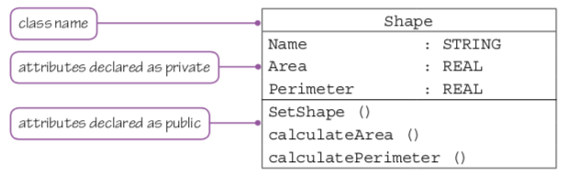
OOP Terms – Classes – (part 3)
Class Name = Red box
Class Attributes = Blue box
Class Methods = Green box
Public = Green
Private = Blue
And here is why OOP terms suck, because even in your book it says the green box things are attributes, which they are because attributes are things inside a Class, but really these are Class Methods because they link to other functions within your code

Slide 23
Classes and Objects
Okay, so you want to make an Object, you know you need a template for this Object. This template is called a Class.
Can I make 1 class to make many Objects
Yes. As long as the Objects are the same, you can make many Objects from one Class
So can we say that a Class is used to create Objects?
No.
We cannot say “…create Objects” we have to say “…create instances of an Object”
Instance = one (of)
So if I made my class and I used it to create 25 objects, I have to say I have 25 instances of an object.

Slide 24
OOP Terms - Objects
So if I have a copy of an object its called an instance.
Objects can also have
Data, Methods, Properties, Actions, Behaviours
The information about an object is called its Data
So for example, our Shape Class is used to make instances of Squares, Triangles and Circles. The information about an individual square, (the area, perimeter and name) are the Object’s Data. (ANNOYING….Some places say Object Data is the same as Object Information and it’s the same as Object Attributes)
If our Object can do something, then we say our Object has an Action.
Actions are also called behaviours
If your Object has Object Data and Object Action, then those are the Object Properties. Your object will always have Object Data at least so that’s why sometimes Object Data is also called Object Information and its same as Object Attributes and it’s the same as Object Properties)

Slide 25
Quick Review
We’ve covered the yellow ones so far:
Properties, Methods, Instance, Inheritance, Polymorphism, Containment, Aggregation, Encapsulation, Deconstruction, Getters, Setters, Attributes, Public, Private, Behaviours

Slide 26
Inheritance
You make a Class.
You give it some data and methods.
You now want to make a new class and want copy things from your first class to this new class.
You don’t say copy. You say inherits.
Things in your new ‘child’ class inherit things from its ‘parent’ class
Inheritance = When a class has copied data from another class
Multiple Inheritance = When your class is made up of data from more than one Superclass

Slide 27
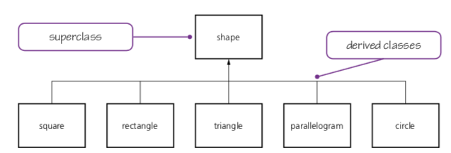
Superclass
New word, and its most stupid.
You made a class to help you make objects.
But now you make some new classes that inherit things from your existing Shape Class.
Your original Shape Class is now called a Superclass
If you wondering what derived class means, it a way of saying a class that has been made. You don’t need to say derived. Too many stupid words.

Slide 28
Polymorphism
Poly = Many
Morph = Forms
When many different objects respond to the same command but they respond differently depending on the code in that object.
SIMPLE: When one Object can be used to give you different answers in different scenarios
Example your Shape superclass has a property called ”number of sides”
Your square subclass has the value of 4
The triangle subclass has the value of 3
The circle subclass has the subclass of 1
So in your program, if you have something that’s asks for the number of sides then your code will pass the value from that specific object.
So you will say the same command “How many sides” but depending on the object the message passing will either say 4, 18 or 6 depending on the object.

Slide 29
Polymorphism Example
Problem: Some places say polymorphic just means different answers, some places say its different TYPES of answer.
Example: The function len( ) will calculate the length of something
len( ) is just one function but it’s a polymorphic function because I can get different TYPES of result based on my input.
Code | Result | Explain
print(len(”Batman")) | 6 | Number of letters in Batman
print(len([”Cat", ”Dog", ”Horse"])) | 3 | How many items in my list
print(len({"Name": ”Amar", "Address": ”UK"})) | 2 | How many keys in my dictionary (Name and Address)

Slide 30
Overloading (part 1)
Overloading is another stupid term.
Inside your class you have methods. These are the external pieces of code within your class. (Green box)
And we said that your child class inherits things from its parent. So the Triangle class has everything from the Shape superclass.

Slide 31
Overloading (part 2)
But, what if you want to change the methods in the triangle class?
You can.
Changing the inherited methods is called Overloading
It happens a lot with Polymorphism too.
Really, you are kind of making a new class but with CS they like having stupid words and like making themselves seem smart by making thing complex.
Have a class? Made another class based on the first class? Want to change its methods. Do it, its called Overloading.
Why do it?
Change the code so it exactly fits your needs.
Your class can have the same name but do different things

Slide 32
Quick Review
We’ve done the yellow ones. The pink ones are bonus ones
Properties, Methods, Instance, Inheritance, Polymorphism, Containment, Aggregation, Encapsulation, Deconstruction, Getters, Setters, Attributes, Public, Private, Behaviours, Superclass, Overload

Slide 33
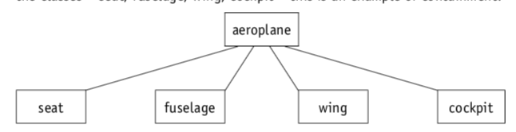
Containment / Aggregation
Containment is the same as aggregation.
It just means when one class is made up from other classes
So the aeroplane class is made up from a seat, fuselage, wing and cockpit class.
Aeroplane Class is an aggregation / containment of the other classes.

Slide 34
Constructor
You made a class to use as a template to make an object.
But the life of an object has different stages
What was it called when you make a copy of an object?
Instance
What is used to as a template to make an object?
Class
What is it called when you actually make your first object? When it first gets created?
Constructor

Slide 35
Getters, Setters, Destructors
Ahhhh more dumb terms.
If I say:
A = 4
What’s my variable name?
A
What’s my data value?
4
Okay, now check out the code on the next page:
It creates a class called Superhero and allows you to give a power level to a superhero.
Task:
What does each line of the code do?

Slide 36
class Superhero:
def __init__(hero, power = 0):
hero._power = power
def get_power(hero):
return hero._power
def set_power(hero, x):
hero._power = x
Batman = Superhero()
Batman.set_power(88)
print(Batman.get_power())
print(Batman._Power)
Makes a class
Defines the class. Gives it attributes Hero and power. power set to 0
Says the value of hero.power is same as power
Defines new function called get_power. You give it hero
It returns hero power
Defines new function called set_power, you give it hero and x
Says hero.power is equal to x
Makes a new object called Batman with the attributes of the Superhero class
Sets the power level for Batman
Gets the power level for Batman
Prints the power level for Batman

Slide 37
Getter and Setter
You see how we got data in lines 5 and 6
And you see how we gave data in lines 8 and 9
But we didn’t directly touch the variables in lines 2 and 3.
We used two different functions to get information and to set information.
These are getter functions (line 5 &6)
And setter functions (line 8 & 9)
Notice that we didn’t actually set any data until line 13, but we made a setter function ready for it.
And we didn’t actually receive anything until line 15 and 17 but we made our getter function in line 5 and 6
class Superhero:
def __init__(hero, power = 0):
hero._power = power
def get_power(hero):
return hero._power
def set_power(hero, x):
hero._power = x
Batman = Superhero()
Batman.set_power(88)
print(Batman.get_power())
print(Batman._Power)

Slide 38
Destructor
This is code used to delete an object.
You may need to delete an object to free up your memory
def __del__(”THE NAME OF YOUR OBJECT”)

Slide 39
Finally
We’ve done the yellow ones. The pink ones are bonus ones
Properties, Methods, Instance, Inheritance, Polymorphism, Containment, Aggregation, Encapsulation, Deconstruction, Getters, Setters, Attributes, Public, Private, Behaviours, Superclass, Overload

Slide 40
Practice
We just did a lot of stuff about the terms used for OOP.
Now we shall practice.
Pages 502 onwards of your Hodder Course book has the code, but for ease I put them here.
Task for the 3 examples of code:
1. Make sure it works.
2. Give comments / label the parts of the code that use our keywords:
Properties, Methods, Instance, Inheritance, Polymorphism, Containment, Aggregation, Encapsulation, Deconstruction, Getters, Setters, Attributes, Public, Private, Behaviours, Superclass, Overload

Slide 41
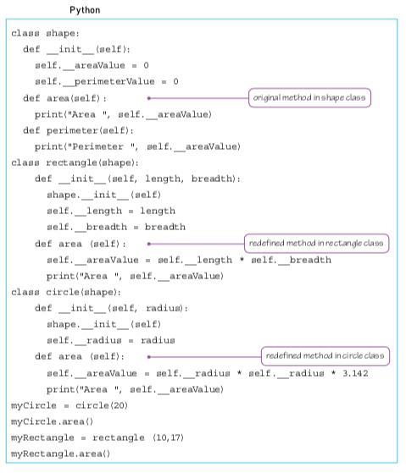
Example 1

Slide 42
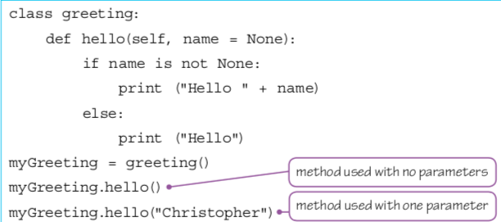
Example 2

Slide 43
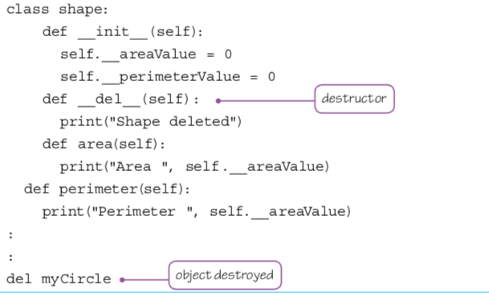
Example 3

Slide 44
Last Paradigm
So we did low level paradigm. (uses low level code)
Did imperative or procedural. (does the things in order that you wrote them)
Did Object Orientated Programming (uses classes and objects and stupid words)
Next is the best paradigm:
Declarative

Slide 45
Today
Declarative programming:
understanding of and ability to solve a problem by writing appropriate facts and rules based on supplied information
understanding of and ability to write code that can satisfy a goal using facts and rules
Understand: What is declarative programming
Able: Explain facts and rules
Answer: Where do we use declarative programming?

Slide 46
Declarative
Lets say you have a list of items
EvilPeople = [”Joker", ”Lex Luther" , ”Bane", ”Scarecrow", ”Thanos"]
And you want to make it so anyone who wants to find someone can search and find them.
What algorithm could you use?
Linear Search
Binary Search Tree (you wouldn’t really use this)
So then you go ahead and write the code for linear search
key = input ("What do you want to find?")
for counter in range(0,len(EvilPeople)):
if EvilPeople[counter] == key:
print ("Found it!")
else:
print("Nope")

Slide 47
Declarative
So you had a list of items, you know you wanted to be able to search though it and YOU had to write the code to tell the computer how to search.
If you didn’t write the code for linear search then the computer can do nothing.
Declarative programming is NOT this.
Declarative programming is when you tell the computer what you want, the computer then does it for you and you DO NOT have to tell the computer HOW to do it.
There are two main programming languages that are declarative. SQL and Prolog. We will look at SQL.
But before we do, we have to talk about rules and facts.

Slide 48
Facts and Rules
Declarative programming does not work by magic.
Although you do not need to tell the computer HOW to get data you do have to tell the computer what are the facts and rules.
Facts are just anything that is known.
So in our example we know Joker, Lex Luther, Bane, Scarecrow, Thanos
Rules are the relationship between facts.
Our example is too simple, we have no relationships. So lets make our data a little more complex so we can make some rules. We will make a table and still call it EvilPeople

Slide 49
Rules and Facts
So now we have many facts.
And we can say our rule is that one line holds the name, comic series and evil rating for one person.
So in SQL we can type:
SELECT Name, Evil Rating
FROM EvilPeople
WHERE Evil Rating > 50
ID | Name | Marvel or DC | Evil Rating
1 | Joker | DC | 80
2 | Lex Luther | DC | 45
3 | Bane | DC | 30
4 | Scarecrow | DC | 90
5 | Thanos | Marvel | 10

Slide 50
Facts and Rules
SELECT Name, Evil Rating
FROM EvilPeople
WHERE Evil Rating > 50
This should give the answers of: Joker 80
Scarecrow 90
You did not tell the computer HOW to find the data, it just did and you don’t care HOW.
That’s declarative. Just say the facts and rules and the programming language does the rest for you
ID | Name | Marvel or DC | Evil Rating
1 | Joker | DC | 80
2 | Lex Luther | DC | 45
3 | Bane | DC | 30
4 | Scarecrow | DC | 90
5 | Thanos | Marvel | 10

Slide 51
Why?
We use declarative mainly for databases, knowledge bases and for queries.

